Slide 1
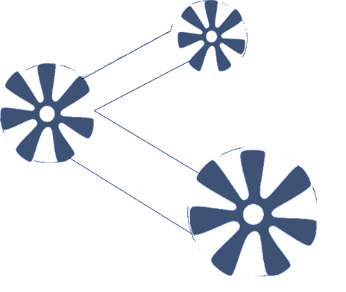




Slide 2
Automated machıne learnıng
AutoML
Ömer Adıgüzel

Slide 3



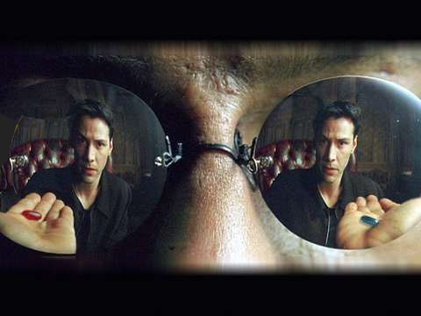
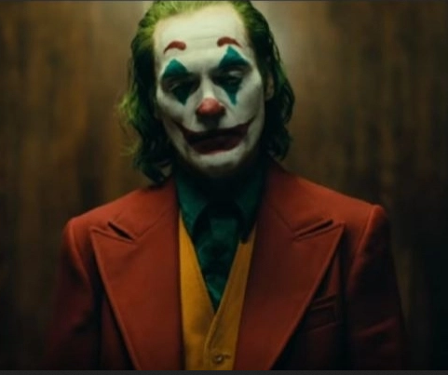


Why AutoML ?
HYPERPARAMETER TUNING
FEATURE ENGINEERING
WHICH MODEL ?
REPRODUCIBLE
DATA CLEANING

Slide 4
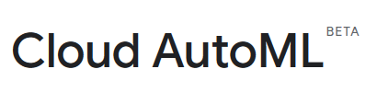
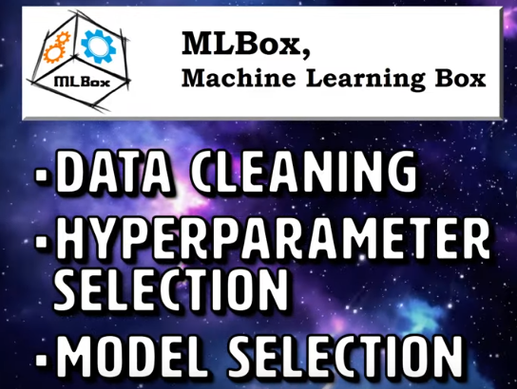
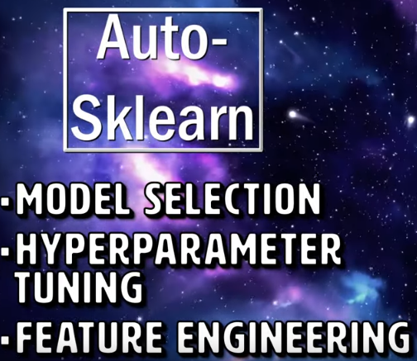
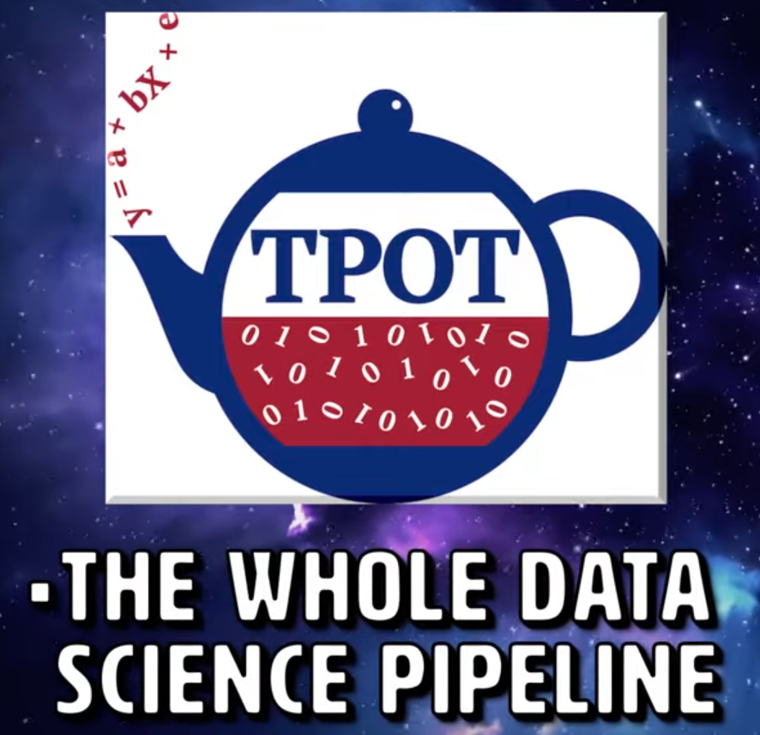
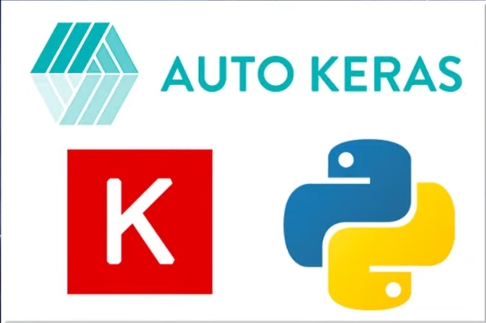
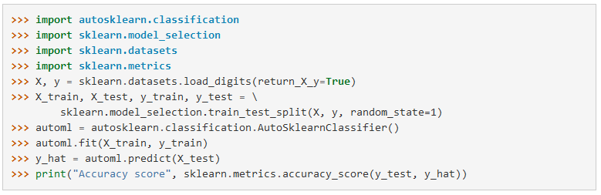
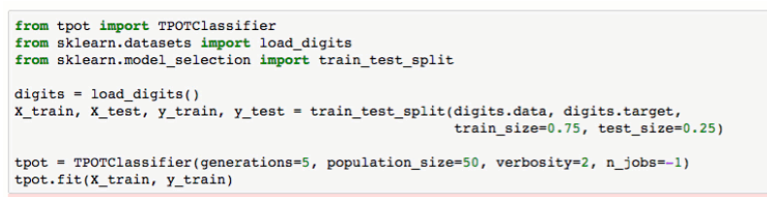
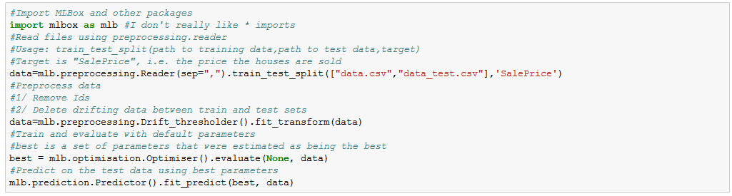
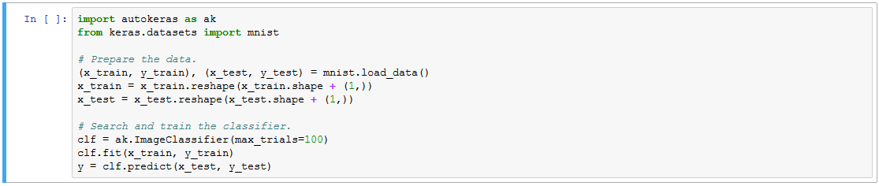
Transfer Learning
Neural Architecture Search

Slide 5
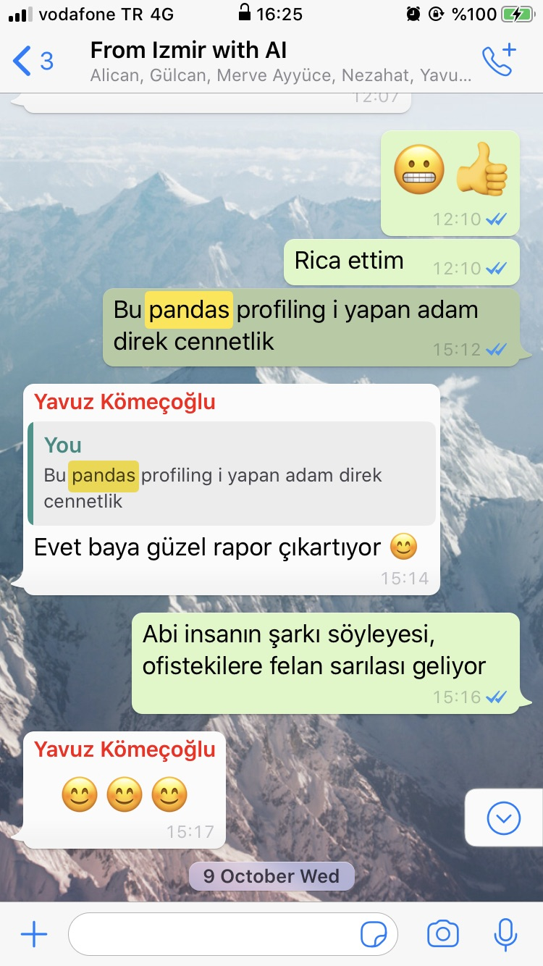
esquisse:::esquisser()
pandas_profiling
radiant:::radiant()

Slide 6
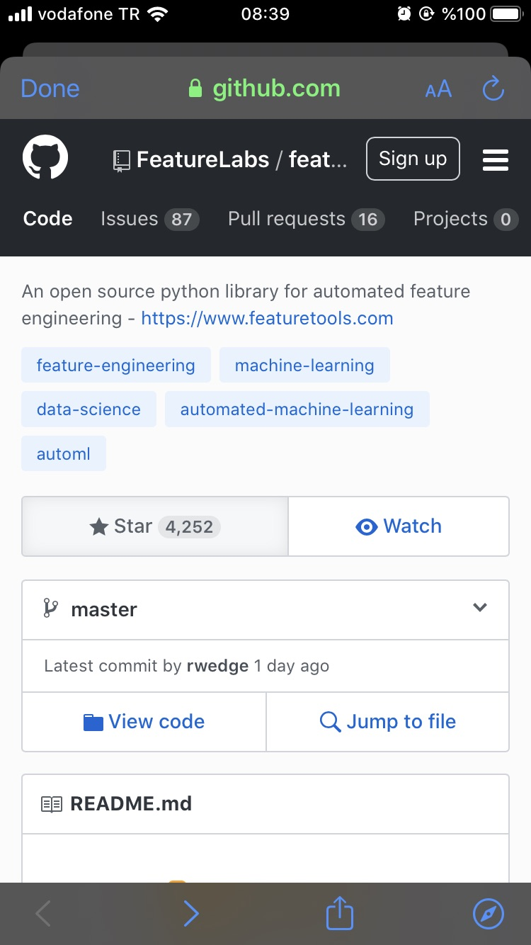
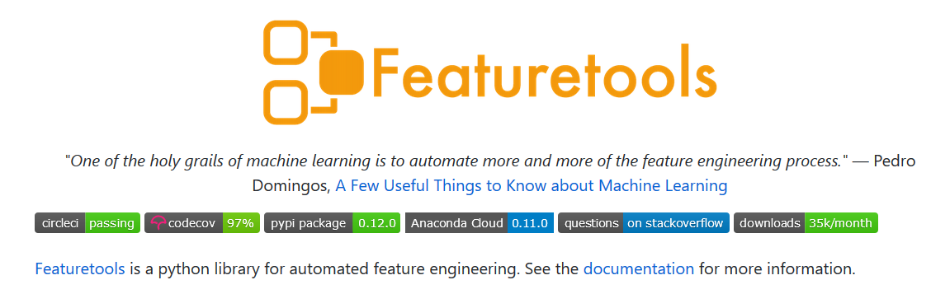

Slide 7
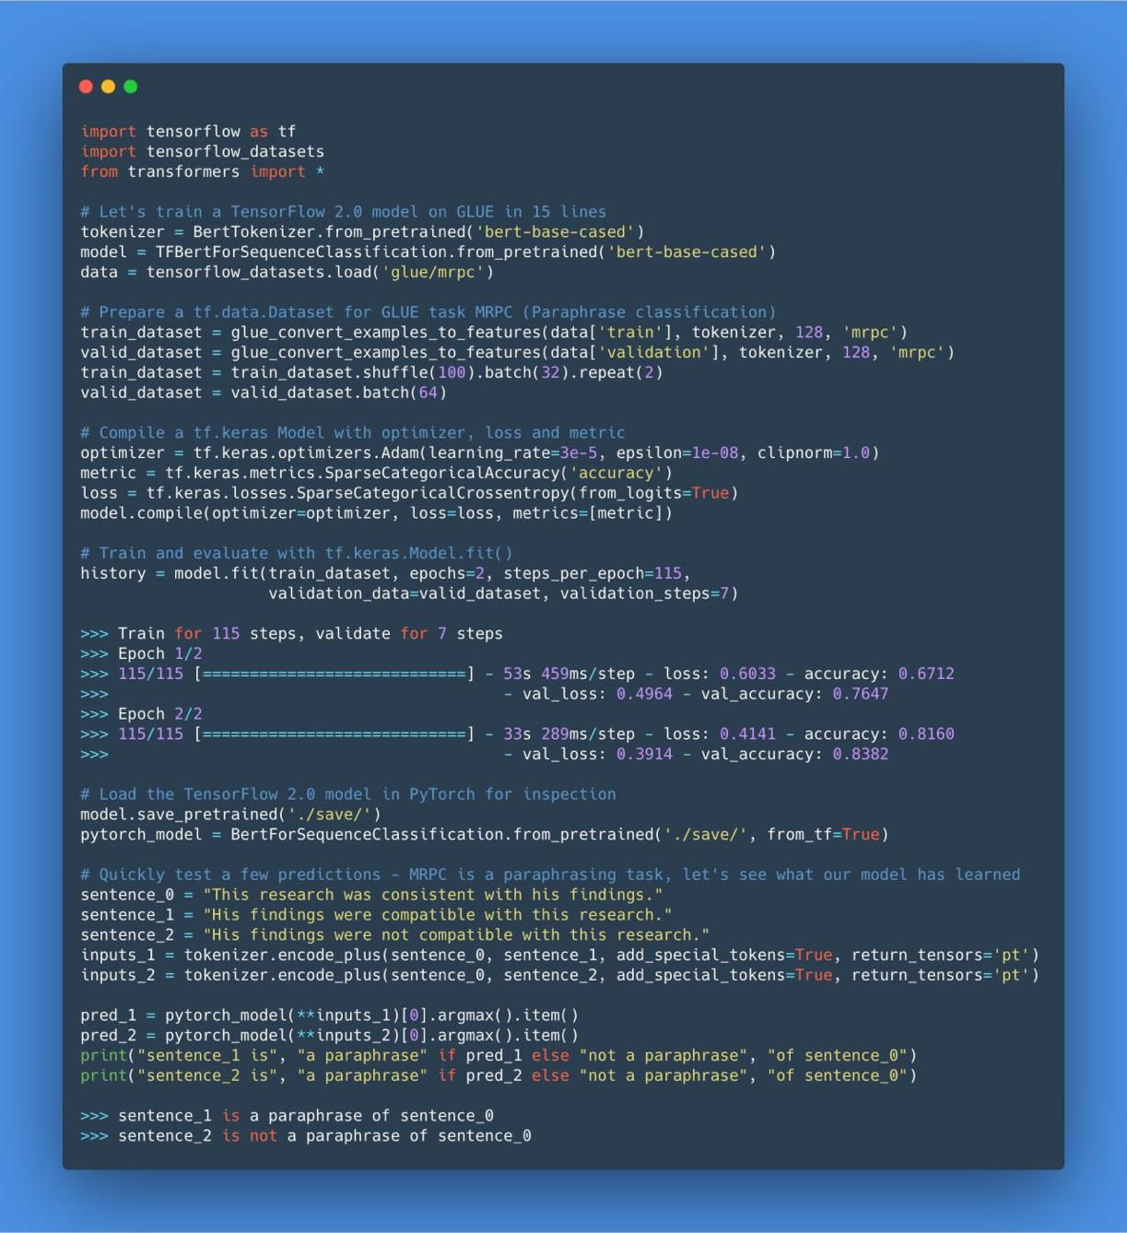
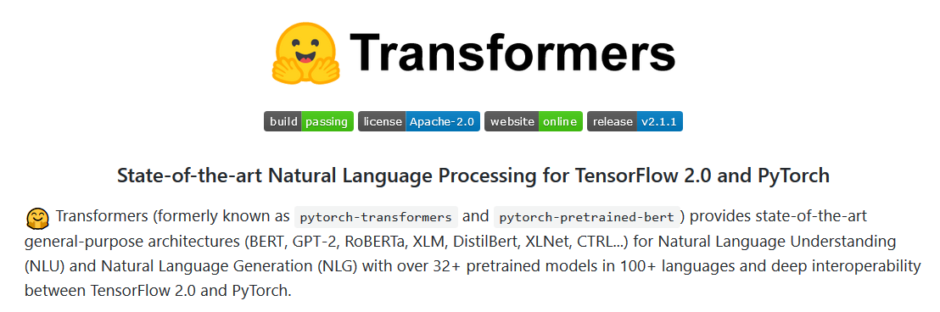

Slide 8

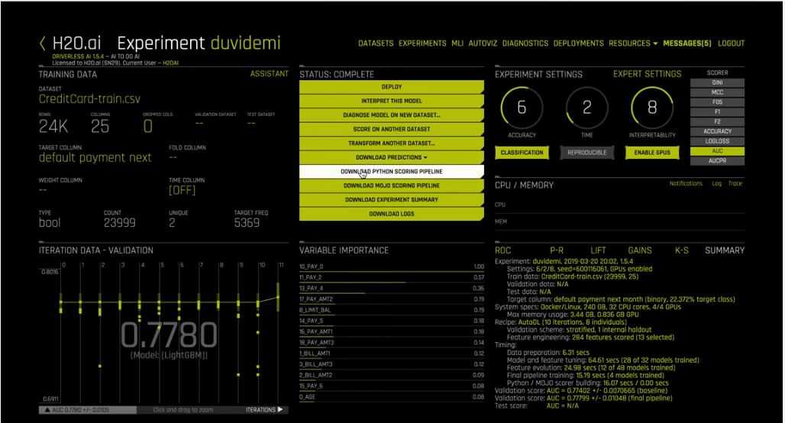

Slide 9
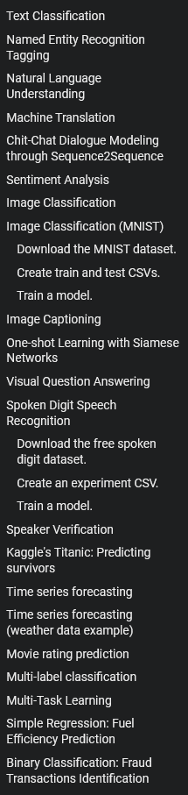


Slide 10

docker run --rm -v %cd%:/usr/tmp/dataset ludwig experiment --data_csv /usr/tmp/dataset/train.csv --model_definition_file /usr/tmp/dataset/model_definition.yaml --output_directory /usr/tmp/dataset/output
docker run -it --entrypoint /bin/bash -v %cd%:/usr/tmp/dataset/ ludwig
ludwig visualize -v learning_curves -ts D:\titanic\dataset\output\experiment_run_0\training_statistics.json

Slide 11



